Slide 1
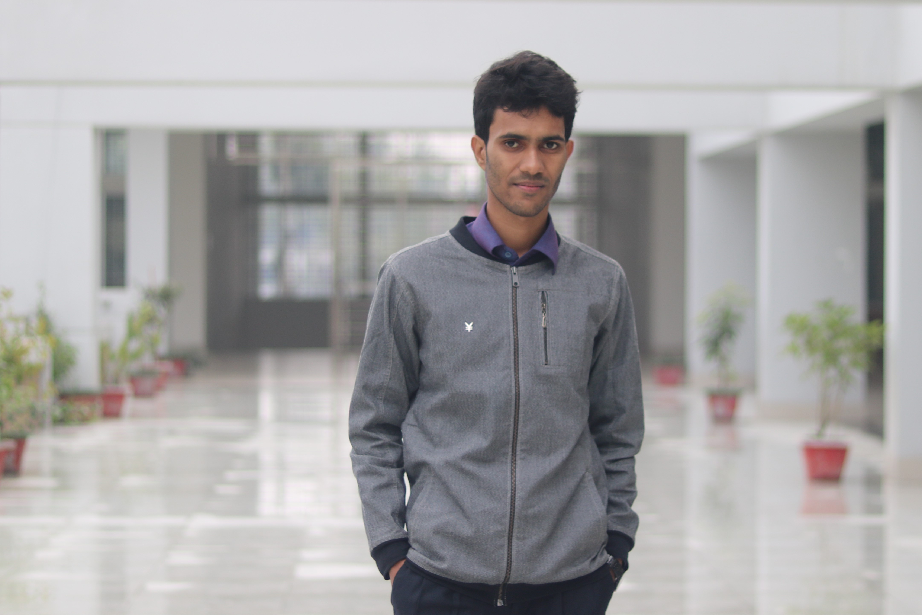
Rahat Mahmud Khan
Student, BSc 4th year, Department of Computer Science and Engineering, KUET
Contact Information:
Address:
BOF, Gazipur Sadar, Gazipur
Phone No:
+8801888102099
Email:
khan1707040@stud.kuet.ac.bd
Find Me:
Facebook:
https://www.facebook.com/rahat.rmk
LinkedIn:
https://www.linkedin.com/in/rahat-mahmud-khan-016756169/
Portfolio:
To know Me more:
PROFESSIONAL EXPETIES :
Web Developer & Project Manager at OSS Trading (2019-21)
OSS Trading
QUALIFICATION:
Khulna University of Engineering & Technology
Student, 4th year, BSc in Computer Science and Engineering (2018- Current)
Rajuk Uttara Model College, Uttara, Dhaka
Higher Secondary Certificate (2017)
GPA: 5.00/5.00
Rajendrapur Cantonment Public School & College, Rajendrapur, Gazipur Secondary School Certificate (2015)
GPA: 5.00/5.00
PROFESSIONAL SKILLS:
Programming Languages:
C, C++, Python
Web Based Languages & Framework:
HTML, CSS, PHP
Specialized Area:
Web Development, Project Development & Handling

Slide 2
SKILLS:
Software Skills:
Proficient with Microsoft Word, Excel and PowerPoint.
Languages:
Bengali – Native
English – Secondary/Fluent
PROJECTS:
Library Management System
Language/Feature used: C++
A console feature for any School and College to Management Library by using the object-oriented property of C++
KUET-BUS TIME Scheduling App
Language/Feature used: Java, Firebase(server), Android Studio
Link: KUET-BUS App
An android project based on java & XML as a development tool & Firebase as the server for showing the Time Schedule of KUET BUS.
Face-Mask Detection with Convolution Neural Network
Language/Feature used: Python, CNN model,
Link: Face-Mask Detection
A transfer Learning-Based Convolutional Neural Networking System is used for detecting mask and without mask Faces to ensure the safety of the people and it can be also used for the ATM booth to protect from the bogus people
PHP project for Conserving Study Material
Language/Feature: HTML,CSS, PHP & JavaScript
Link: Study Material
Arduino Based Automatic Home Monitoring System Using Mobile-Phone
Language/Feature used: Arduino UNO, Bluetooth Module, Relay, Arduino IDE
A Bluetooth sensor is used here for transmitting and receiving signals to ON/OFF the light automatically and monitoring them.

